Slide 1
How does a change in the population age distribution affect the macroeconomy?
Ronald Lee
University of California at Berkeley
rlee@demog.berkeley.edu
Prepared for NTA13 2020
I am grateful to Gretchen Donehower for data analysis, and to many NTA country teams for their generosity in sharing their data.

Slide 2
Changing population age distribution affects
Labor supply
Savings and consumption
Assets and capital
Public and private transfer flows
These affect productivity, wages, interest rates, consumption and income.
NTA profiles describe these patterns.

Slide 3
“Consumption per effective consumer” is outcome of interest here.
Contrast outcomes according to three measures.
Support Ratio (SR) measures dependency on labor income
But many people use asset income to fund consumption, not transfers. Are they really dependent?
Open Impact Index (OII) (formerly General Support Ratio) includes asset income by age.
takes wages and interest rates as given
appropriate for open economy.
Closed Impact Index (CII) also includes assets
Wages and interest rates depend on capital relative to labor.
More capital raises wages and reduces interest rates.

Slide 4
Model
Assume a Cobb-Douglas production function for a closed economy with no technological progress
Labor income is wage w(t) times effective labor.
Effective labor L(t) is sum of pop age distribution times baseline y_{l} profile.
wage w(t) depends on K(t)/L(t)
I treat Assets and Capital as equivalent)
Asset holdings are estimated from baseline NTA asset income profile.
Effective assets K(t) are sum of pop age distribution times baseline y_{A} profile divided by baseline interest rate.
Not built up dynamically/longitudinally through saving.

Slide 5
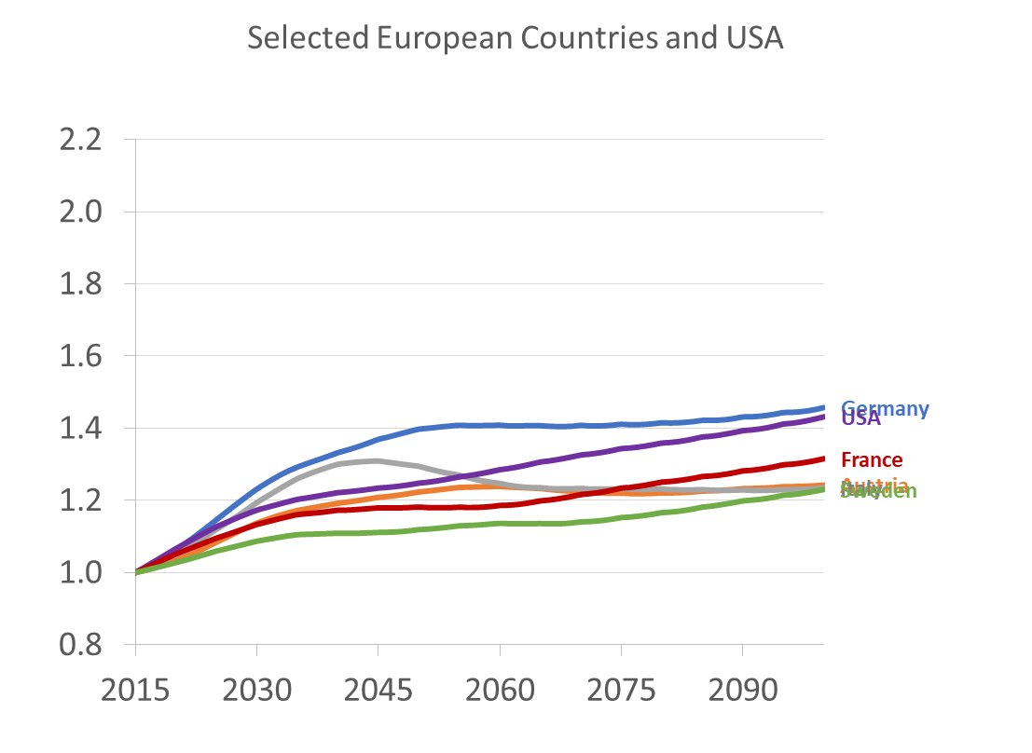
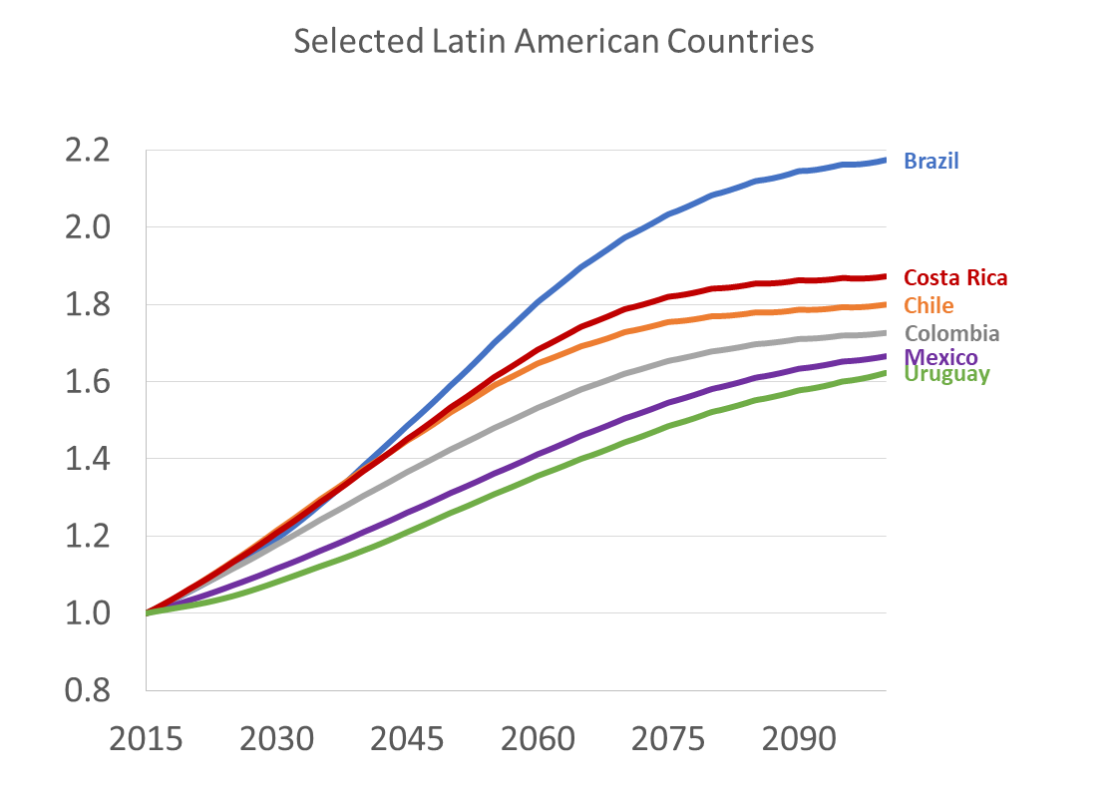
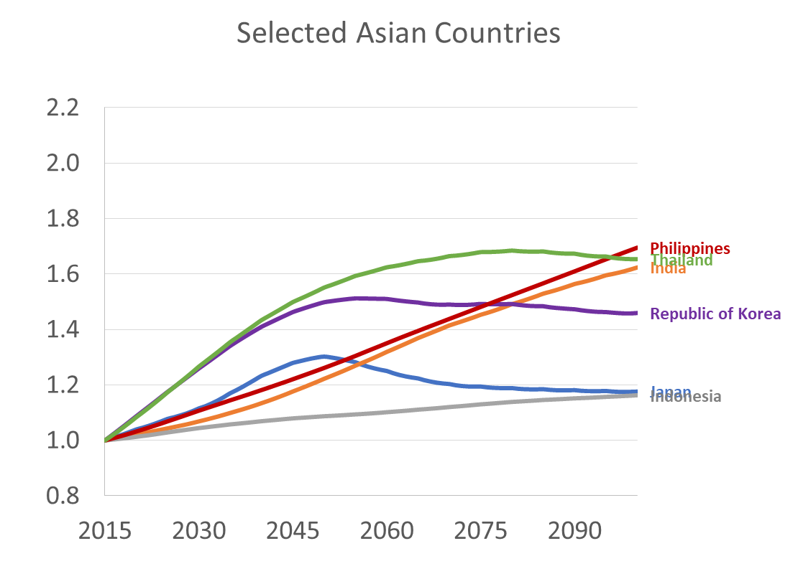
For closed economy case: Simulated change in ratios of capital to labor (K/L) and Wage to Interest Rate (w/r) relative to 2015
Europe & US
Latin America
Asia
Brazil
Chile, Costa Rica
Philippines, India, Thailand
Germany, US
Mexico, Uruguay
Sweden, Austria, Italy
Japan, Indonesia
If pop aging raises capital more than labor, the capital intensity of the economy rises.
Labor productivity and wages rise, and interest rates fall.
Countries with biggest increases are earlier in the demographic transition.
Falling interest rates may be an issue; open financial markets will help rich countries.

Slide 6
Now compare measures of consumption per effective consumer
SR (Support Ratio)
CII (Closed Impact Index)
OII (Open Impact Index)

Slide 7
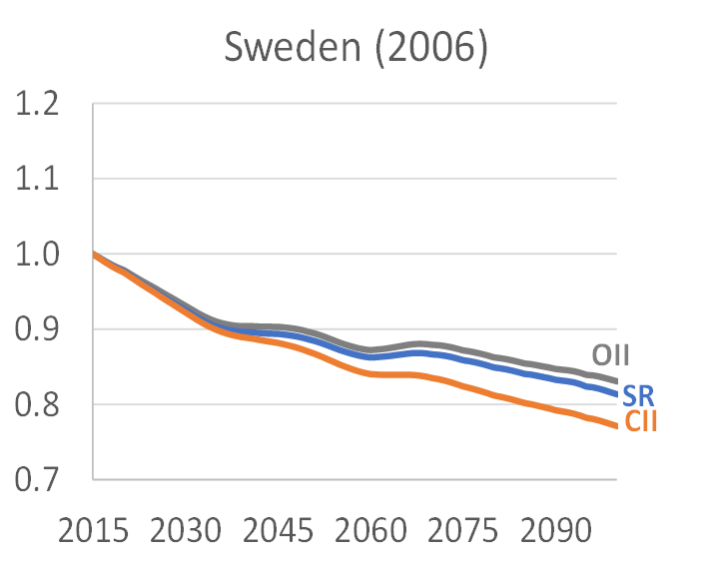
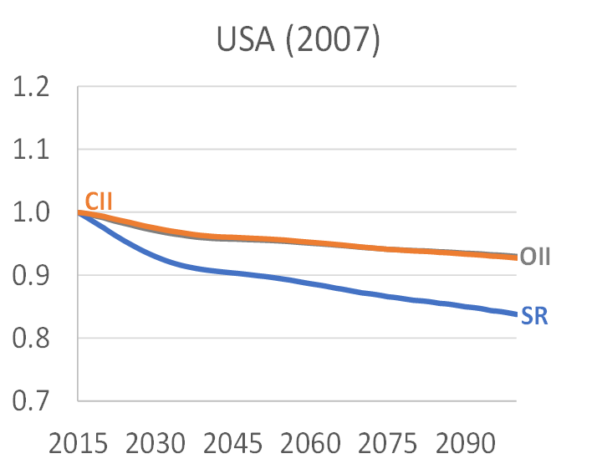
Institutions matter: Elderly rely more on public transfers in Sweden vs asset income in US where public pensions are low.
Lower saving Fewer assets
Little capital intensification.
Pop aging more costly
Greater assets
More capital intensification
Offsets dependency cost of pop aging (open or closed).

Slide 8
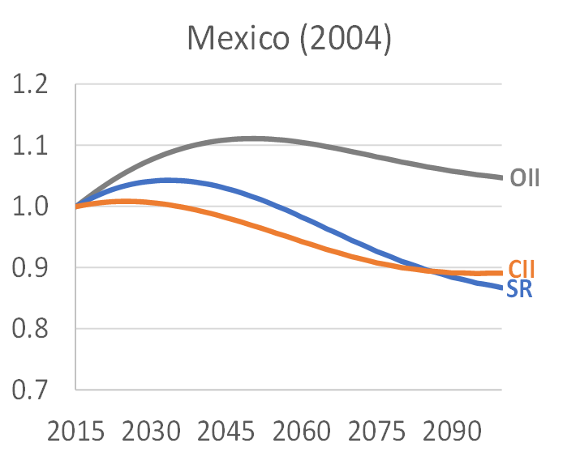
*Support ratio shows dividend. *In closed economy capital dilution reduces dividend (SR). *Foreign investment In open economy prevents capital dilution, raises and prolongs dividend. *Foreign investment may bring other problems not considered here.
Mexico’s dividend phase

Slide 9
How would .5 births above or below UN Medium TFR projection impact each measure?
Next chart shows ratio of High or Low Fertility outcomes to Medium variant outcome for each measure: Support Ratio (SR) Closed Economy index (CII) Open Economy index (OII)

Slide 10
Germany typical of High Inc
With low TFR support ratio would be higher for 40 yrs, then lower. Capital intensification keeps economy strong after even after 40 years.
Closed index
Open index
Support ratio

Slide 11
Mexico typical of developing countries.
Compare SR and CII with low fertility
Dividend larger and longer with capital whether open or closed cases.

Slide 12
Conclusions – with capital, dividend looks bigger and pop aging less costly.
Dividend greater and longer than support ratio suggests.
Lower fertility would raise consumption in all countries, including Low Fertility High Inc, for at least 40 years.
Lower fert would raise capital intensity in all countries, offseting rising old age dependency.
Wages will rise relative to interest rates.
In some countries lower vs higher fertility would make little long run difference.

Slide 13
END

